Slide 1



Group 4
04/29/2025
STUDENT DEPRESSION ANALYSIS
PRESENTED BY:
Hongbei Li, Ashley Kao, Matt Yang

Slide 2


Agenda
03 | Overview
04-05 | Dashboard 1_ Drepression Analysis on Demographics and Family Risk Factors
06-07 | Dashboard 2_Depression Analysis on Lifestyle
08-10 | Dashboard 3_Student Mental Health and Academic Pressure Analysis
11 | Conclusion
12 | Thank you

Slide 3

Dashboard 1
This dashboard highlight how demographics and personal risk factors like family mental health history and financial stress impact outcomes. Users can select a city to explore family history prevalence, depression rates, average age, locations, and the link between financial stress and depression.
03/10
Overview
This project aims to support the study of depression among students by analyzing various influencing factors using data derived from Kaggle. The dataset captures information across three primary dimensions:
1. Demographics
2. Academic Indicators : such as GPA, academic pressure...
3. Lifestyle & Wellbeing Ex: sleep duration
We explore how these factors relate to student depression to identify key risk indicators and guide targeted mental health support.
Dashboard 2
The dashboard shows that poor sleep, heavy study load, and unhealthy diet are strongly linked to higher student depression rates, with gender differences across all factors.
Dashboard 3
This dashboard provides an overview of students’ mental health and academic performance based on degree type, gender, and geographic region.

Slide 4

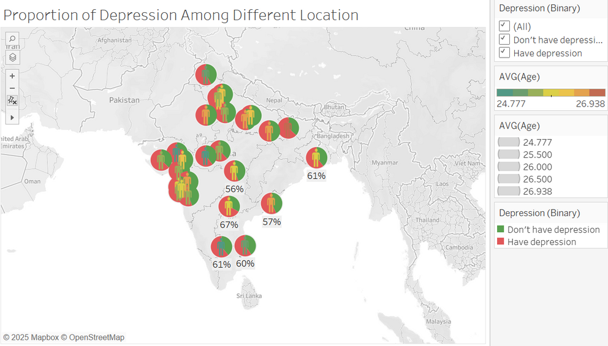
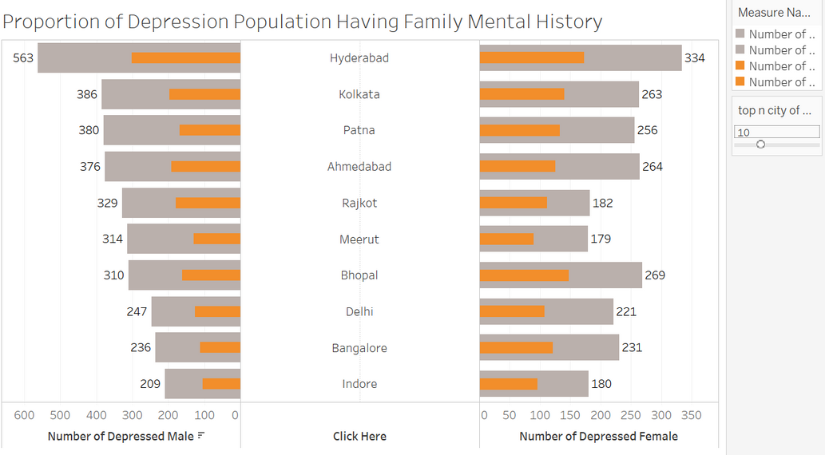
Analysis on Demographics and Family Risk Factors
04/10
We began by identifying the distribution of respondents to assess whether the age data was biased and to understand their geographic spread. Since the original City field contained many input errors that made mapping difficult, we created a Cleaned City field with standardized names. Using this data, we generated a map to visualize the age and city distribution of respondents, allowing us to see both geographic coverage and the proportion of depressed individuals in each city.
This graph allows users to select the top N cities with the highest depression rates among males and females, and shows, among the depressed individuals, the proportion with a family mental health history. We found that across cities, about half of the depressed students had a family history and half did not, suggesting that while family history may be a contributing risk factor, it is not a sole determinant of individual depression

Slide 5
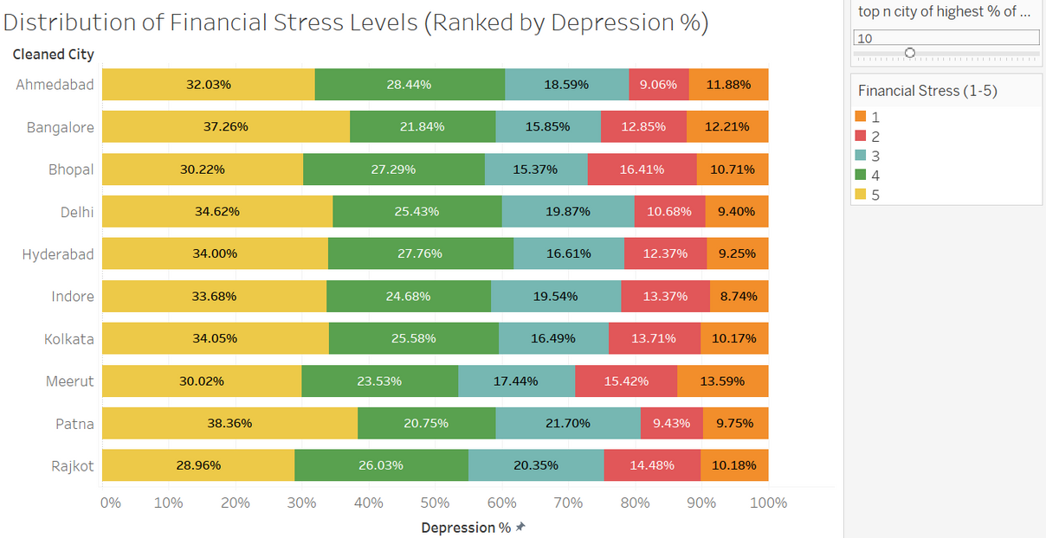
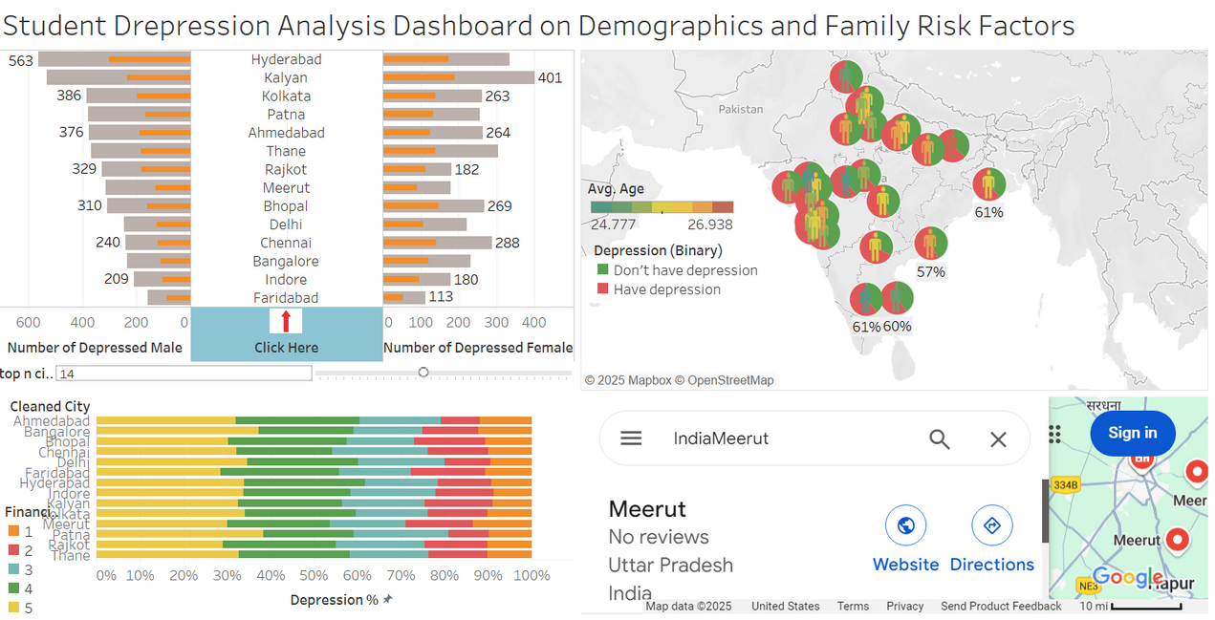
Analysis on Demographics and Family Risk Factors
05/10
This chart allows users to explore the distribution of financial stress levels among depressed individuals. We found that across all cities, stress levels 4 and 5, the highest categories, account for over 50% of cases, indicating that most depressed individuals experience high financial stress.
The final dashboard allows users to click on a city, applying a filter and highlighting its location on Google Maps. First, users can explore the percentage of depressed individuals with a family mental health history through a butterfly chart, visualizing the relationship between these two factors. Next, users can examine the average age of respondents and the proportion experiencing depression in each city. Finally, users can assess whether higher financial stress levels are positively correlated with depression. By examining these aspects, we can better understand the roles of demographics and family risk factors in contributing to student depression.

Slide 6
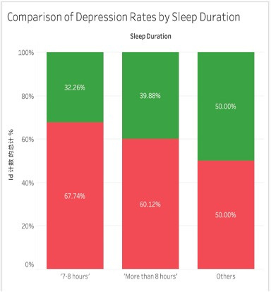
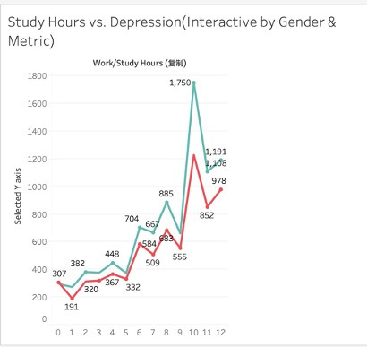
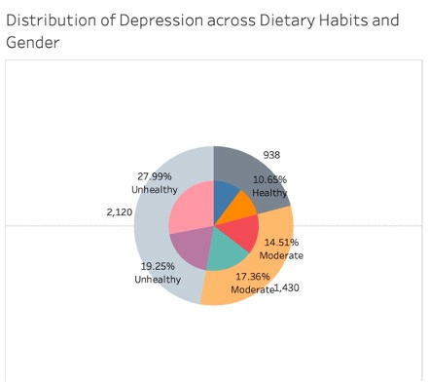
Analysis on Lifestyle (sleep, dietary habits, study hours)
06/10
Stack Bar Chart
Line Chart (Interactive by Parameter Control):
Pie Chart
Content: Depression Rate by Sleep Duration
→ Finding: Short sleep duration (less than 7 hours) is associated with a significantly higher depression rate.
X-axis: Study Hours
Y-axis: Flexible (Num of Depression, Total Students, Depression Rate%)
→ Finding: As study hours increase, depression numbers rise, especially more sharply in females.
Content: Distribution of depression across dietary habits and gender
→ Finding: Students with unhealthy diets show higher proportions of depression, particularly among females.

Slide 7
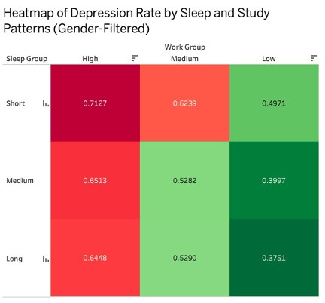
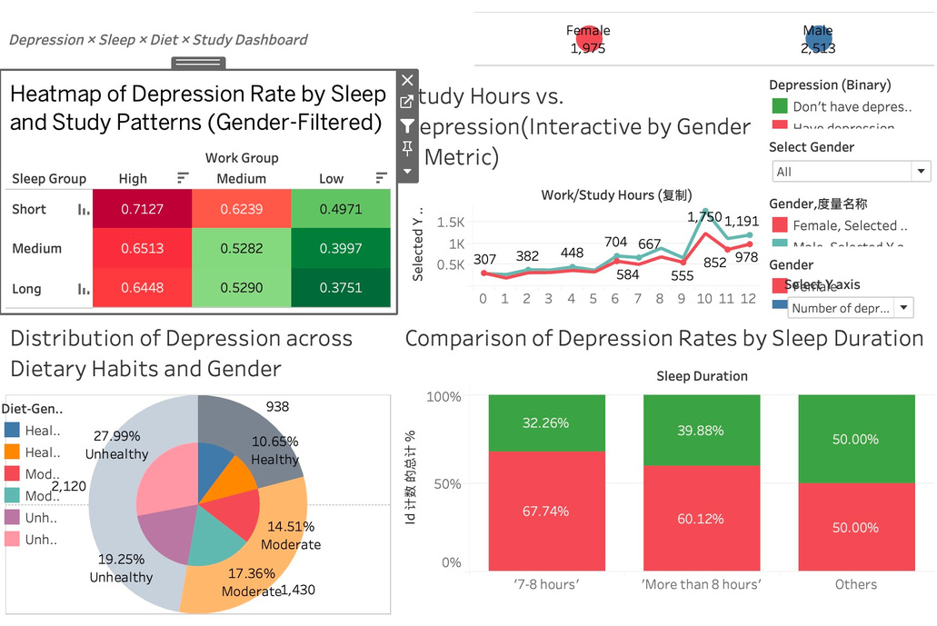
Analysis on Lifestyle (sleep, dietary habits, study hours)
07/10
This dashboard explores how lifestyle factors relate to student depression.
The heatmap shows that short sleep and heavy study workloads are linked to higher depression rates.
The line chart reveals gender-based trends in depression across different study hours.
The pie chart highlights that students with unhealthy or moderate diets are more prone to depression.
The stacked bar chart confirms that longer sleep is associated with lower depression rates.
Overall, the dashboard shows that sleep, diet, and workload significantly impact student mental health.
Heatmap
X-axis: Study Hours Group (High/Medium/Low)
Y-axis: Sleep Duration Group (Short/Medium/Long)
Color intensity: Depression Rate
→ Finding: Students with shorter sleep and higher study hours have the highest depression rates.

Slide 8
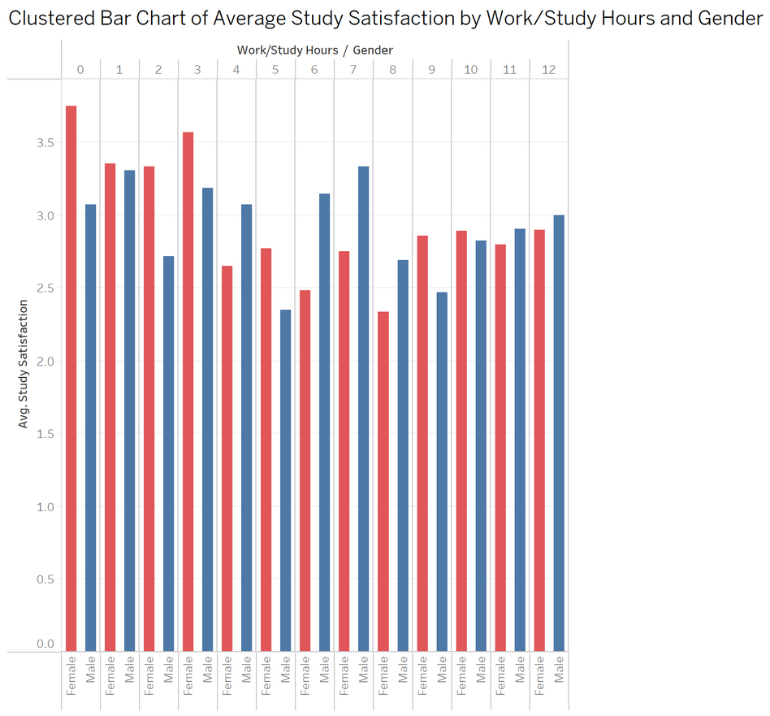
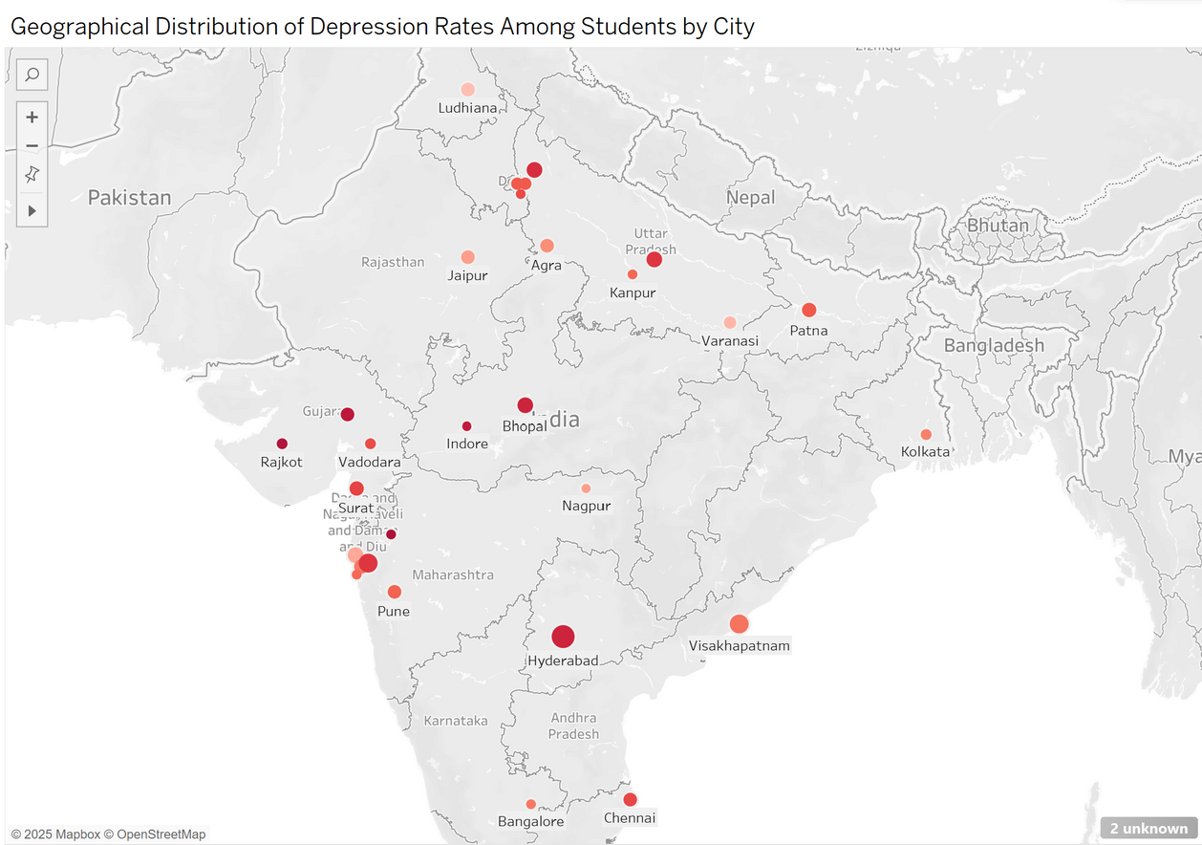
Student Mental Health and Academic Pressure Analysis
08/10
This clustered bar chart shows the average study satisfaction across different weekly work/study hours, split by gender. A downward trend is observed as hours increase, indicating that heavier workloads are generally associated with lower satisfaction. Female students tend to report higher satisfaction than male students across most hour levels, especially when work/study hours are low.
This map displays the geographical distribution of depression rates among students across various Indian cities. Darker red circles indicate higher depression ratios. The visualization reveals that cities in central and western India, such as Hyderabad, Surat, Indore, and Bhopal, tend to have higher depression rates compared to those in the east.

Slide 9
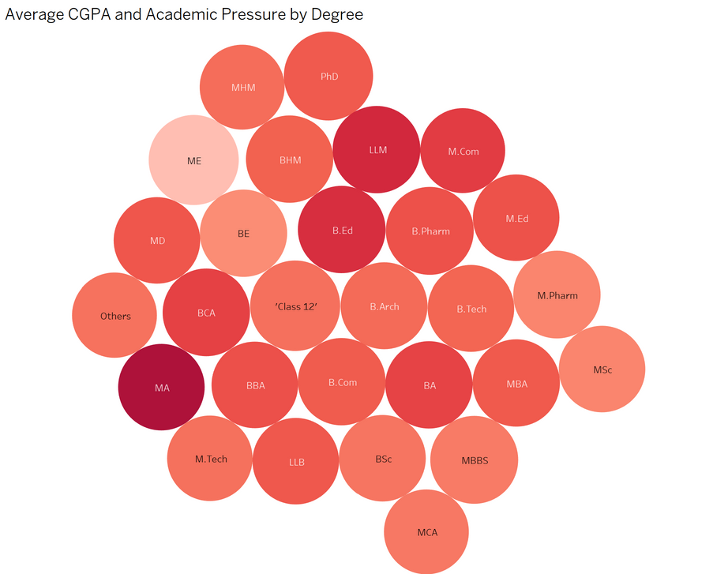
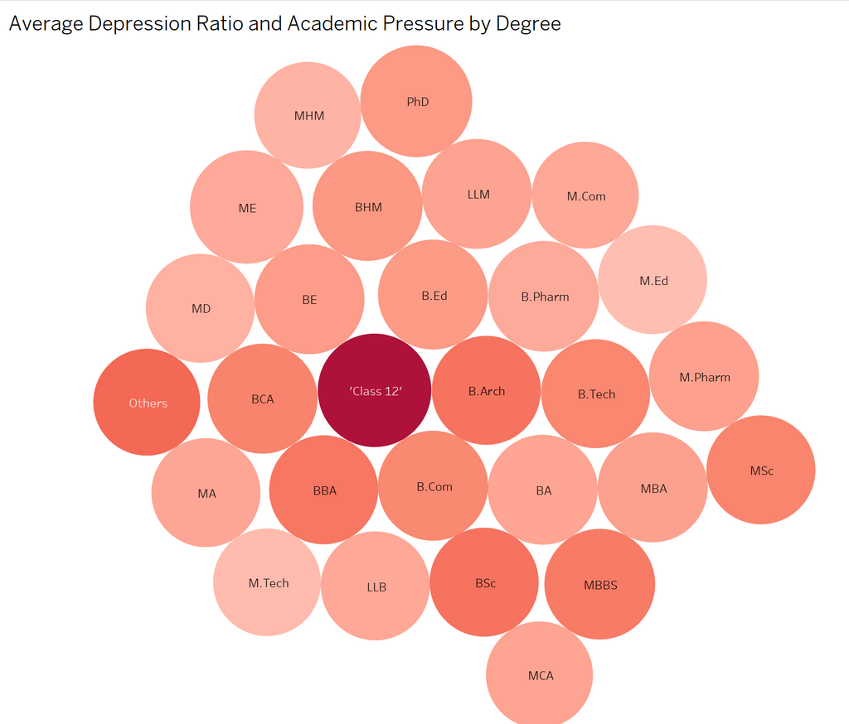
Student Mental Health and Academic Pressure Analysis
09/10
This bubble chart compares average CGPA and academic pressure by degree.
Darker color indicates higher CGPA, and larger size shows greater academic pressure.
Programs like M.Com and LLM stand out with both high grades and high pressure.
Overall, the relationship between pressure and performance varies—high pressure doesn’t always mean better or worse academic results.
This bubble chart compares average CGPA and academic pressure by degree.
Darker color indicates higher CGPA, and larger size shows greater academic pressure.
Programs like M.Com and LLM stand out with both high grades and high pressure.
Overall, the relationship between pressure and performance varies—high pressure doesn’t always mean better or worse academic results.

Slide 10
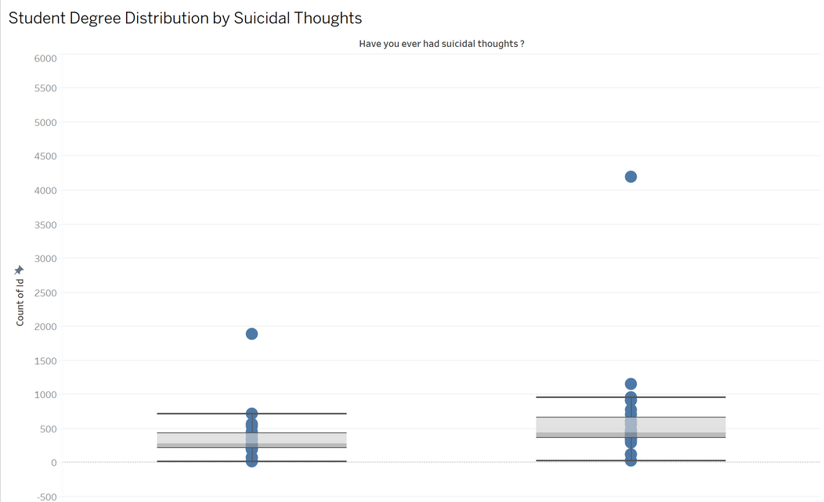
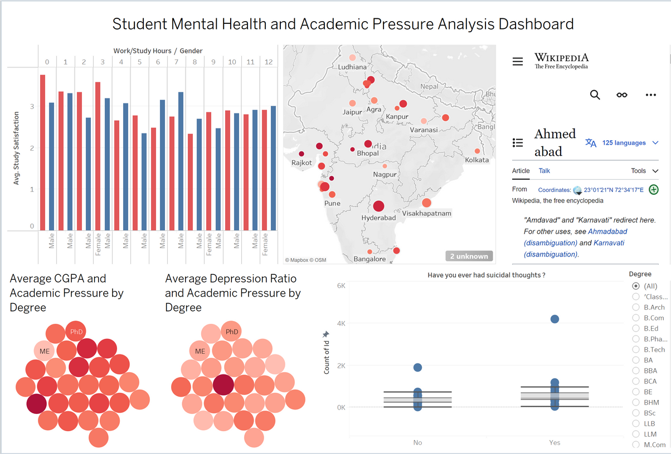
Student Mental Health and Academic Pressure Analysis
10/10
This dashboard reveals several important insights. Students in "Class 12" experience higher academic pressure and report more frequent suicidal thoughts compared to those in other degree programs. Despite the variation in degree types, the average CGPA remains relatively stable. Female students tend to report higher levels of study satisfaction across different ranges of work/study hours. Geographically, cities in central and western India show higher depression ratios than those in the eastern regions. Highlights are used in the dashboard to distinguish between male and female students and to emphasize specific degrees, making patterns and differences easier to observe.
This chart shows the distribution of students from different degree programs based on whether they have ever had suicidal thoughts.
The x-axis represents the response (“Yes” or “No”) and the y-axis shows the number of students (ID count).
We can see that in the “Yes” group, several degree types such as Class 12 have a noticeably high number of students, suggesting a higher proportion of suicidal thoughts within those groups.
This chart helps identify which degree programs may have students at higher mental health risk.

Slide 11
SUMMARY
This project provides an in-depth analysis of the factors influencing student mental health, focusing on demographics, academic stress, lifestyle habits, and family background. We found that students in "Class 12" and degrees such as MA generally experience higher academic pressure and report a greater incidence of suicidal thoughts. Despite the variation in degree types, the average CGPA remains relatively consistent. Additionally, female students tend to report higher levels of study satisfaction across different study hour ranges. Geographically, cities in central and western India exhibit significantly higher depression rates compared to those in the eastern region.
We also examined the impact of family and financial factors. Among students experiencing depression, about half reported a family history of mental illness, suggesting that while family background may be a contributing factor, it is not the sole cause. Furthermore, over 50% of depressed students reported experiencing high levels of financial stress , highlighting the strong link between financial burden and mental health.
Lifestyle analysis showed that short sleep duration and long study hours are closely associated with higher depression rates, especially among female students. Students with unhealthy or average dietary habits also showed higher tendencies toward depression. Overall, student depression is a multifaceted issue influenced by academic pressure, family background, financial stress, and lifestyle choices.

Slide 12
Thank you

